Slide 1
Course project – credit risk analyser

Slide 2
PROBLEM STATEMENT
Challenge: Our consumer finance company, specializing in loans for city dwellers, struggles to approve applicants without a credit history. This can lead to defaults by some borrowers who take advantage of the situation.
Solution: We can leverage Exploratory Data Analysis (EDA) to unearth patterns in our data. This will help us identify creditworthy applicants who might otherwise be rejected due to a lack of traditional credit history.

Slide 3
APPROACH
Loading the data
Check for the missing/null values
Working on missing/null values as per industry standard
Working on modified data
Working on graphs
Finding out of if there any imbalance in the data
Doing Univariant and bivariate analysis
Finding out the correlation between the variables

Slide 4
Missing values
Both the data has missing values. As per the industry standard anything between 40% to 50% is threshold limit.
In previous application
'AMT_DOWN_PAYMENT', 'RATE_DOWN_PAYMENT', 'RATE_INTEREST_PRIMARY', "RATE_INTEREST_PRIVILEGED“, are having missing values.
In application data
'EXT_SOURCE_1', 'EXT_SOURCE_2', 'EXT_SOURCE_3', 'APARTMENTS_AVG', 'BASEMENTAREA_AVG', 'YEARS_BEGINEXPLUATATION_AVG', 'YEARS_BUILD_AVG', 'COMMONAREA_AVG', 'ELEVATORS_AVG', 'ENTRANCES_AVG', 'FLOORSMAX_AVG', 'FLOORSMIN_AVG', 'LANDAREA_AVG', 'LIVINGAPARTMENTS_AVG', 'LIVINGAREA_AVG', 'NONLIVINGAPARTMENTS_AVG', 'NONLIVINGAREA_AVG', 'APARTMENTS_MODE', 'BASEMENTAREA_MODE', 'YEARS_BEGINEXPLUATATION_MODE', 'YEARS_BUILD_MODE', 'COMMONAREA_MODE', 'ELEVATORS_MODE', 'ENTRANCES_MODE', 'FLOORSMAX_MODE', 'FLOORSMIN_MODE', 'LANDAREA_MODE', 'LIVINGAPARTMENTS_MODE', 'LIVINGAREA_MODE', 'NONLIVINGAPARTMENTS_MODE', 'NONLIVINGAREA_MODE', 'APARTMENTS_MEDI', 'BASEMENTAREA_MEDI', 'YEARS_BEGINEXPLUATATION_MEDI', 'YEARS_BUILD_MEDI', 'COMMONAREA_MEDI', 'ELEVATORS_MEDI', 'ENTRANCES_MEDI', 'FLOORSMAX_MEDI', 'FLOORSMIN_MEDI', 'LANDAREA_MEDI', 'LIVINGAPARTMENTS_MEDI', 'LIVINGAREA_MEDI', 'NONLIVINGAPARTMENTS_MEDI', 'NONLIVINGAREA_MEDI', 'FONDKAPREMONT_MODE', 'HOUSETYPE_MODE', 'TOTALAREA_MODE', 'WALLSMATERIAL_MODE', 'EMERGENCYSTATE_MODE',"OWN_CAR_AGE","OCCUPATION_TYPE"

Slide 5
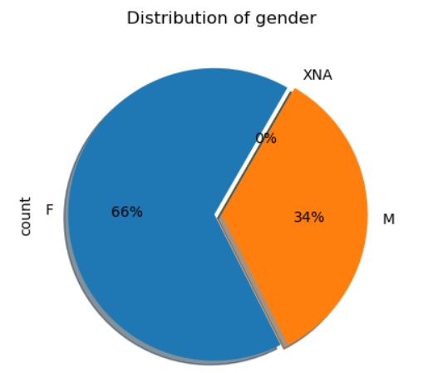
GRAPHS
imbalance percentage
The application data is imbalance data as there are 66% female count compare to just 34% of male

Slide 6
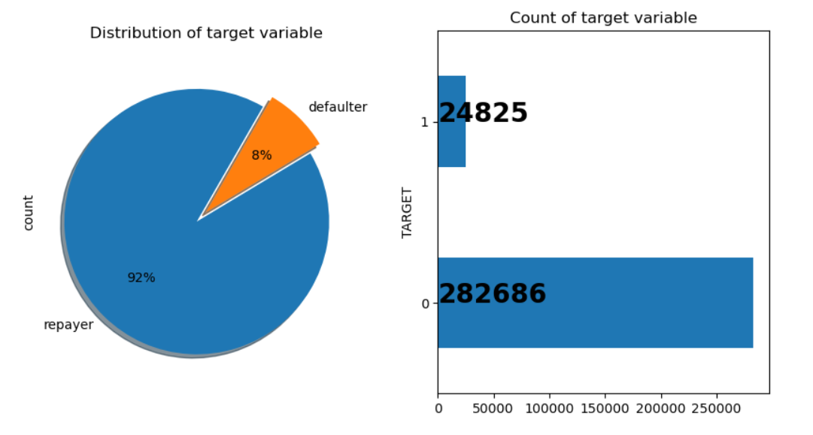
LOAN DEFAULTER
This graph indicate that a total of 8% of population is loan defaulter

Slide 7
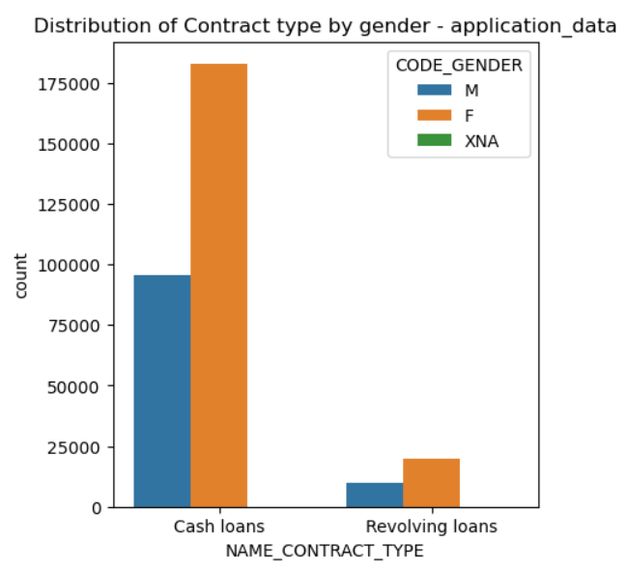
LOAN DISTRIBUTION BY GENDER
In the above graph it shows that cash loan is always preferred compare to the revolving loans by both female and male

Slide 8
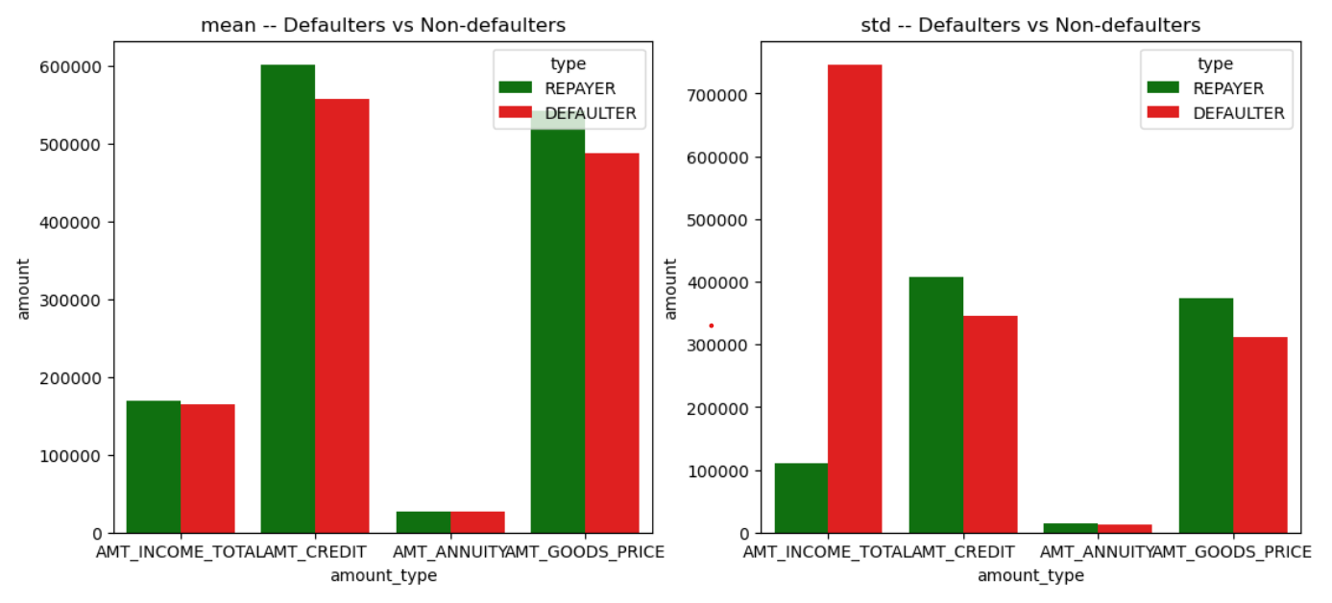
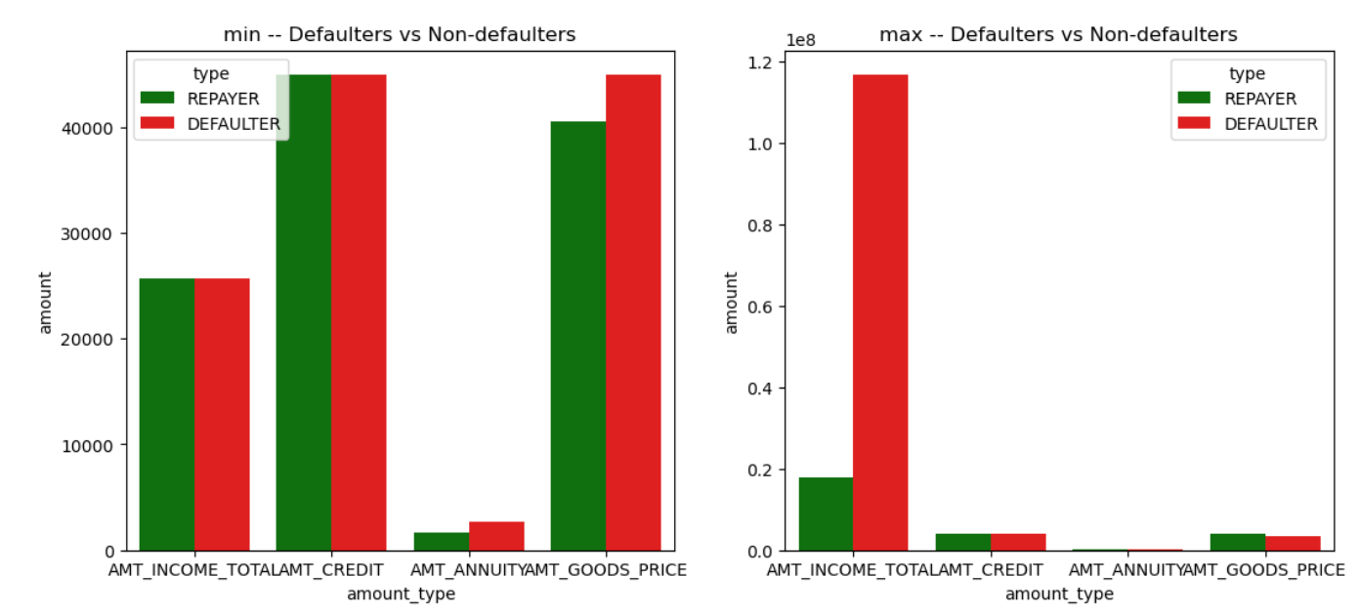
Summary statistics between defaulters and non defaulters
Income of client -
1 . Average income of clients who default and who do not are almost same.
2 . Standard deviation in income of client who default is very high compared to who do not default.
3 . Clients who default also has maximum income earnings
Credit amount of the loan ,Loan annuity, Amount goods price -
1 . Statistics between credit amounts, Loan annuity and Amount goods price given to clients who default and who don't are almost similar.

